Slide 1
Defining Usability and Models of Usability
Usability Engineering: Process, Products, and Examples
Chapter 3

Slide 2
Defining Usability?
“Usability” would seem easy enough to define.
A dictionary definition is still not detailed enough to evaluate whether a system is usable or not.
How could we extend a definition into something that could actually be used to evaluate usability?
Many authors have defined models of usability.
  A model not only states the characteristics of a usable interface but also indicates how those characteristics fit together and what they mean.

Slide 3
Well-Known Models of Usability
There are at least three models.
  Shackel, 1986
  Nielsen, 1993
  Eason, 1984
We will also present a hybrid model.

Slide 4
Shackel’s Model of Usability
Shackel’s model, has four major characteristics or dimensions of usability.
  Effectiveness
  Learnability
  Flexibility
  Attitude

Slide 5
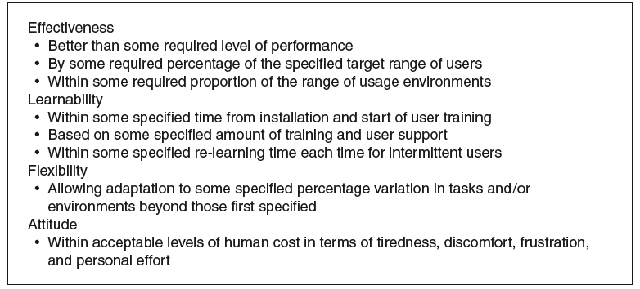
Shackel’s Model of Usability
Notes:
Figure 3.1

Slide 6
Nielsen’s Model of Usability
In the Nielsen model, usability is part of the larger issue of system acceptability.
Nielsen gives five attributes that contribute to usability:
  Easy to learn
  Efficient to use
  Easy to remember
  Few errors
  Subjectively pleasing

Slide 7
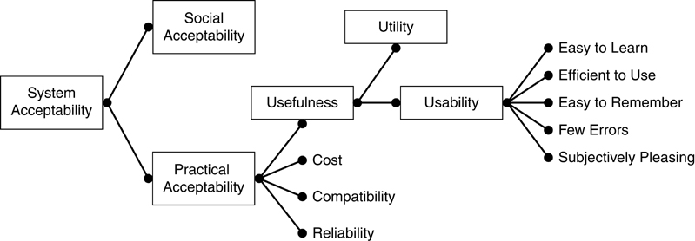
Nielsen’s Model of Usability
Notes:
Figure 3.2

Slide 8
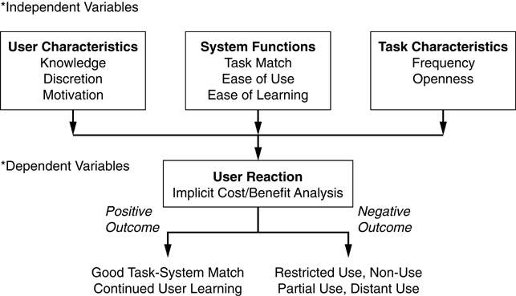
Eason’s Model of Usability
Notes:
Figure 3.3

Slide 9
Eason’s Model of Usability
Usability is an outcome (dependent variable) that results from a combination of system (user interface) characteristics and contextual variables of user and task.
Under each of these dimensions (system, user, task), Eason gives some ideas of what issues affect usability.
Eason's framework is based on a field study that he performed and the variables that he highlighted were the one's that he found to be important in his study.
Notes:
Note - The students probably will understand what you are talking about relative to system characteristics, once they see that the system that you are talking about is the user interface. What they will find much more confusing are those characteristics of tasks and users. You should also stress to them that most of the time we do not get to pick our tasks and users, rather part of the challenge of good usability engineering is to build interfaces for a given group and set of tasks. This is a good time to emphasize that old piece of wisdom "know thy user for they are not you.". Eason is making that point in his model and even giving some ideas of what user characteristics we should be concerned with. Eason goes one step further and indicates that characteristics of the task influence usability also. The implication is that a system that is usable for routine tasks may not be as usable for novel or unexpected applications.

Slide 10
Eason Model
Task Characteristics
Task means what you accomplish with the system or device.
Task characteristics
  Frequency
    Number of times a task is performed by a user.
  Openness
    Extent to which a task is modifiable.
Note the characteristics of the task are independent of the platform in which the task is being performed.

Slide 11
Eason Model
User Characteristics
Eason recognized that characteristics that the user brought to the task and the user interface would influence their experience.
User characteristics
  Knowledge
    The knowledge that the user applies to the task. The knowledge may be appropriate or inappropriate.
  Motivation
    How determined the user is to complete the task.
  Discretion
    The user's ability to choose not to use some part of a system.

Slide 12
Eason Model
System Characteristics
System in Eason’s model refers to the user interface.
System characteristics
  Ease of learning
    The effort required to understand and operate an unfamiliar system.
  Ease of use
    The effort that is required to operate a system once it has been understood and mastered by the user.
  Task match
    The extent to which information and functions that a system provides matches the needs of the user.

Slide 13
Our Usability Model
Situational variable - task
  Frequency
  Rigidness
  Situational constraints
Situational variable - user
  Expertise
  Motivation
User interface characteristics
  Ease of learning
  Ease of use
  Ease of relearning
  Task match
  Flexibility
  User satisfaction

Slide 14
Applying Causal Models
Eason’s model says that usage context, in combination with user interface characteristics, drive and determine usability.
Eason’s model has two parts:
  The “input” to his model are the user/system/task characteristics which are the main categories of independent variables.
  The “outcome” of his model is
  user reaction which is the dependent variable.

Slide 15
Usability of What?
  A usability model can be applied to all facets of a product’s user interface.
  We focus on the specific user interface.

Slide 16
What to Do With Usability Models?
Demonstrate or evaluate existing systems.
Develop systems with a goal of usability.

Slide 17
Conclusions
Usability models suggest that a usable interface will be one that emphasizes
  Ease of learning
  Ease of use
  Good task match
  High levels of user satisfaction

Slide 18
Conclusions
Usability is the result of the interaction of the characteristics of the user interface and the situation.
  Because the usability engineer usually cannot control or change the situation, the best chance for a highly usable interface is to make design decisions that take the variables of the situation into account.

